Slide 1



UNIT 5; Healthy and green
Live smarter

Slide 2
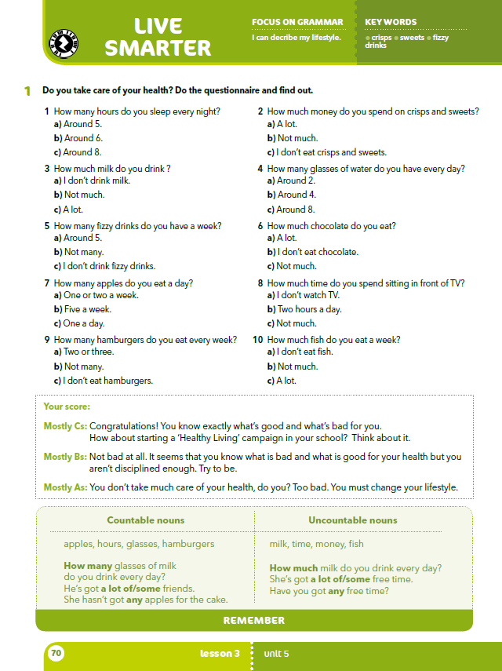
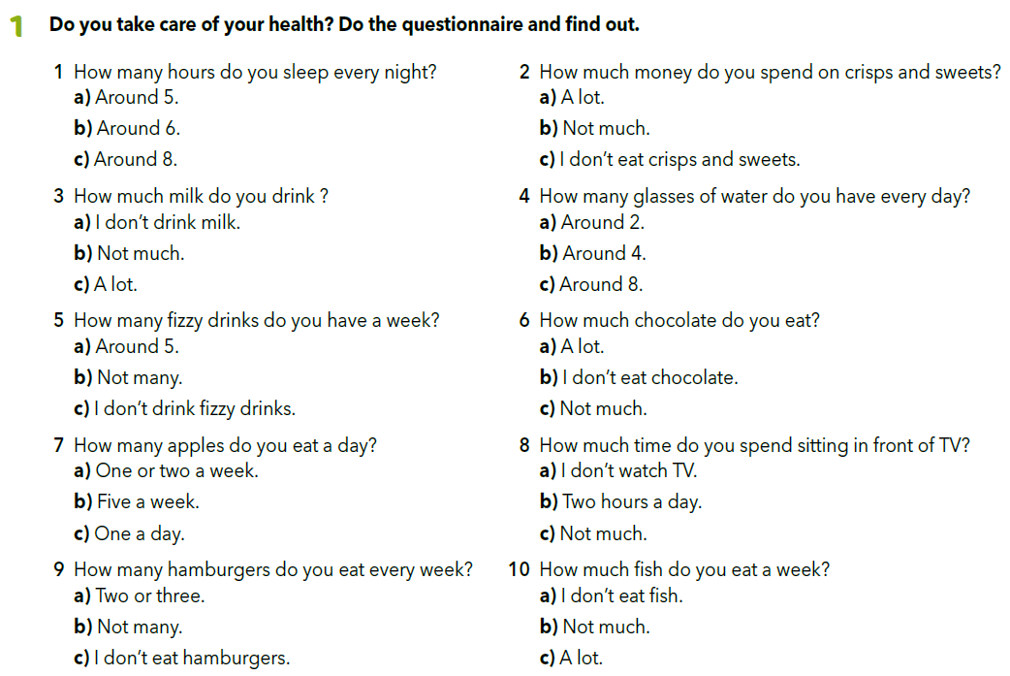
What do like eating? What do you like drinking? Which fruit is your favourite? Which vegetables don’t you like? Can you name five different kinds of drinks? Which of the things we mentioned are good for you?

Slide 3
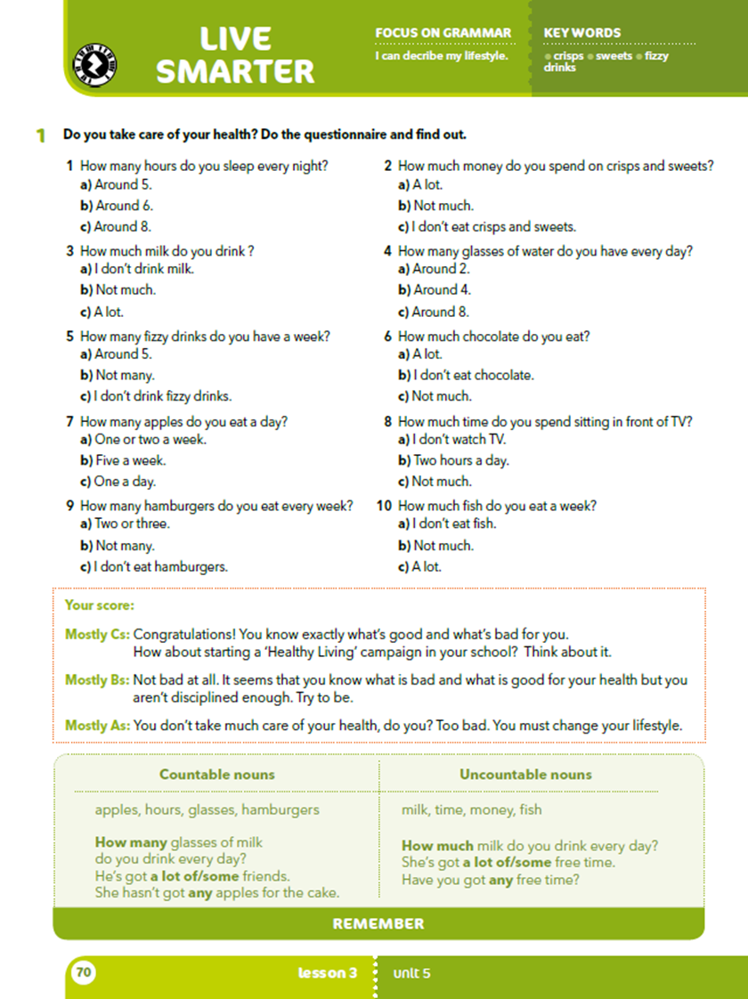
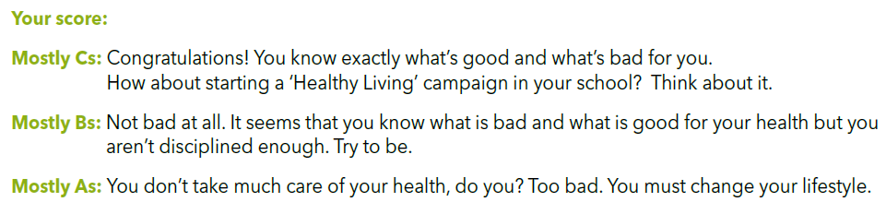
Check your score.

Slide 4
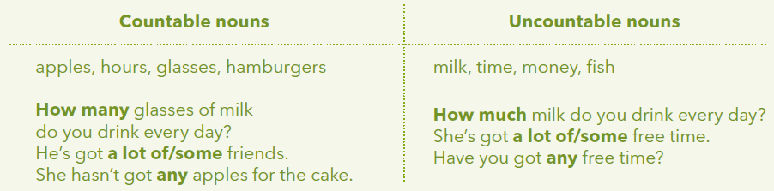
BROJIVE (COUNTABLE) i NEBROJIVE (UNCOUNTABLE) imenice!
Kao što im i samo ime govori brojive imenice možemo brojati
(1 jabuka, 2 jabuke…).
Nebrojive imenice ne možemo brojati, tj da bismo izrazili koliko nečeg ima uz imenicu moramo staviti i neku mjernu jedinicu
(1 LITRA mlijeka, 1 SAT vremena, …).
MONEY, novac je također NEBROJIVA IMENICA jer ne brojimo 1 novac, 2 novca – već 1 kuna, dvije kune…).
Kada želimo pitati koliko nečeg ima za brojive imenice ćemo koristiti HOW MANY, dok ćemo za nebrojive koristiti HOW MUCH?

Slide 5
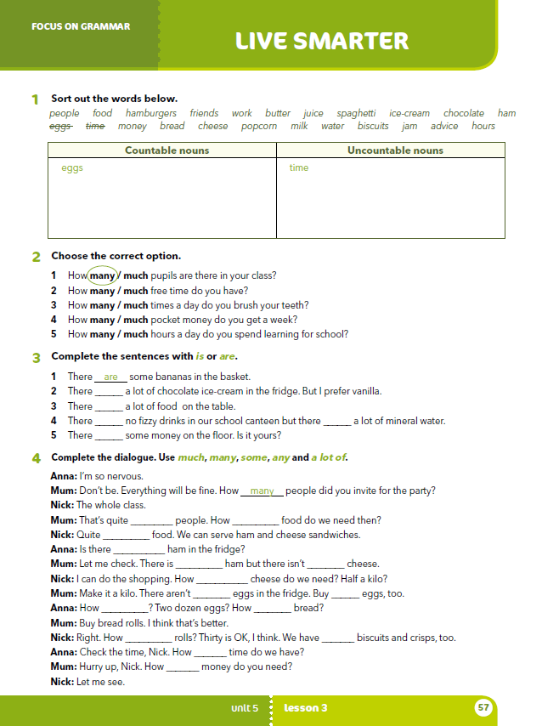
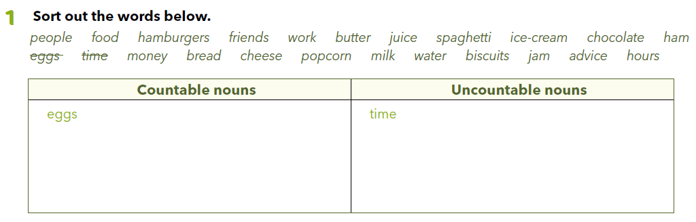
Worbook, p. 57
people, hamburgers, friends, biscuits, hours
work, butter, juice, spaghetti, ice-cream, chocolate, ham, money, bread, cheese, popcorn, milk, water, jam, advice
Practise: https://learningapps.org/watch?v=p4saqz62j20
https://wordwall.net/play/1268/611/883

Slide 6
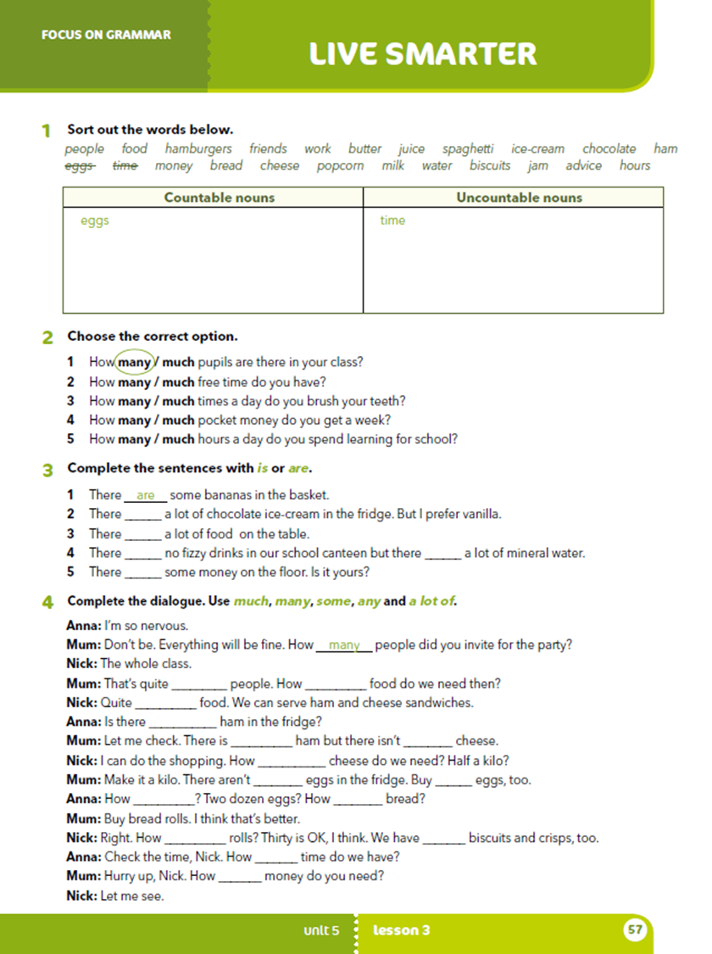
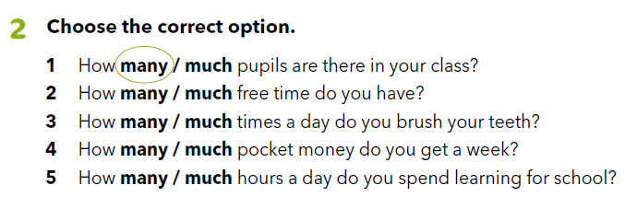

What do people grow in their gardens in our country?
Do people grow same fruit and vegetables all over our country?
What is commonly grown in our area?
Do you know anything about growing vegetables?
Do you and your parents/grandparents grow something in the garden?

Slide 7

LEARN MORE
https://www.e-sfera.hr/dodatni-digitalni-sadrzaji/60588585-6c92-45eb-9214-dc9545e4a383/
Urban gardening

Slide 8
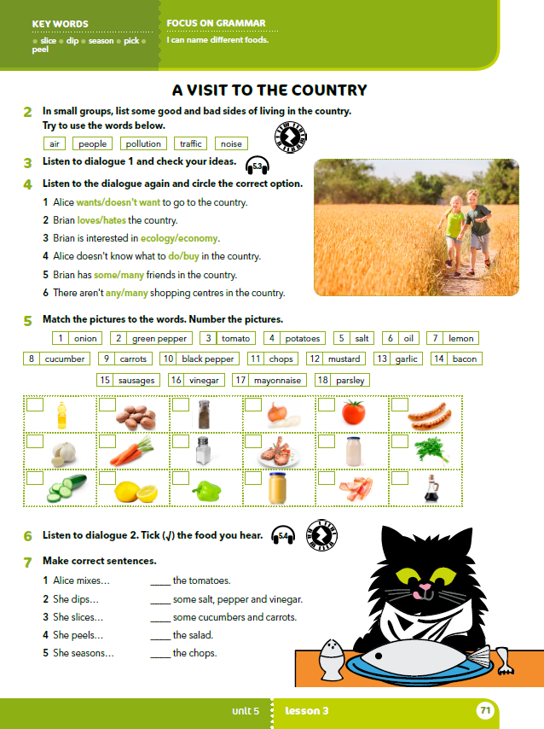
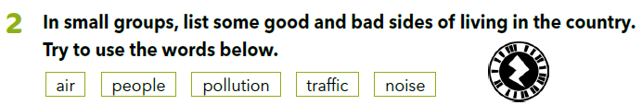


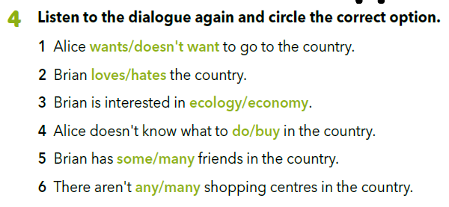
Listen and check your ideas.. https://www.e-sfera.hr/dodatni-digitalni-sadrzaji/60588585-6c92-45eb-9214-dc9545e4a383/assets/audio/25__unit_05_lesson_3_-_a_visit_to_the_country_-_part_1_1.mp3
Listen to the dialogue again and circle the correct option.
https://www.e-sfera.hr/dodatni-digitalni-sadrzaji/60588585-6c92-45eb-9214-dc9545e4a383/assets/audio/25__unit_05_lesson_3_-_a_visit_to_the_country_-_part_1_1.mp3
Check.

Slide 9
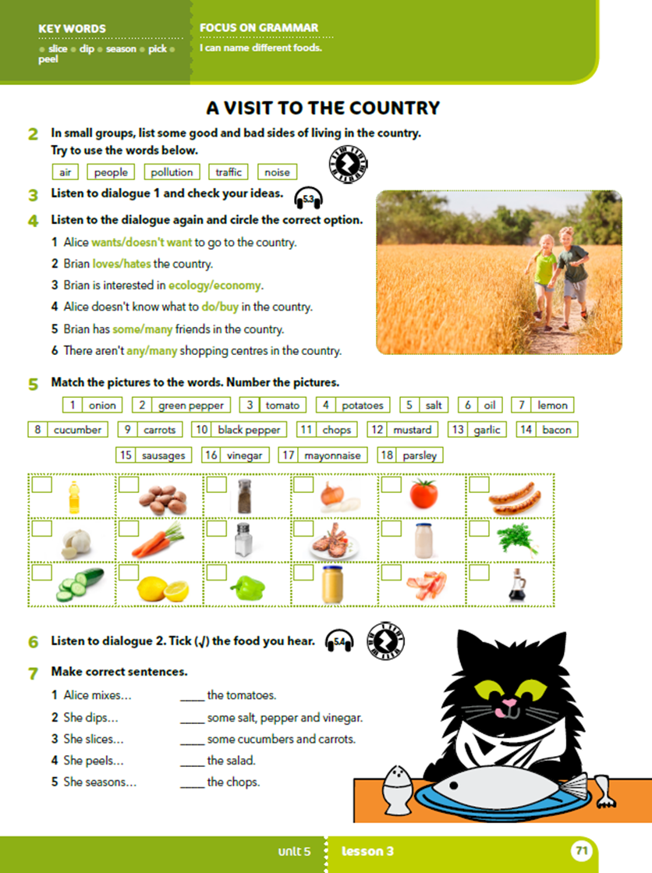
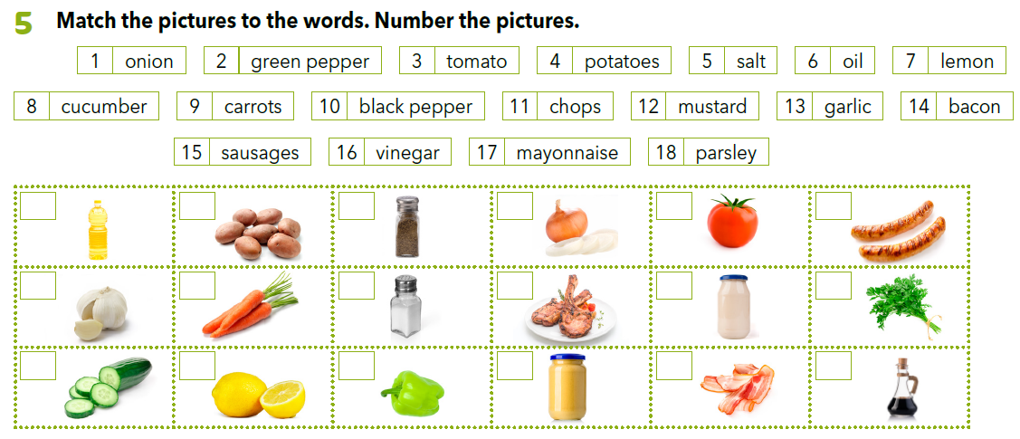
Who is going to the country?
Who are they visiting?
Why isn’t Alice happy about it?
Why is Brian happy about it?
What can you do for fun in the country?
Do you like spending time in the country? Why?
6
4
10
1
3
15
13
9
5
11
17
18
8
7
2
12
14
16
Practise: https://wordwall.net/resource/11188831

Slide 10
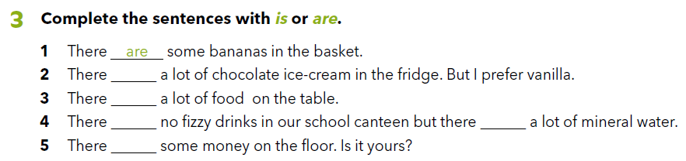
Workbook, p. 57
is
is
are
is
is

Slide 11
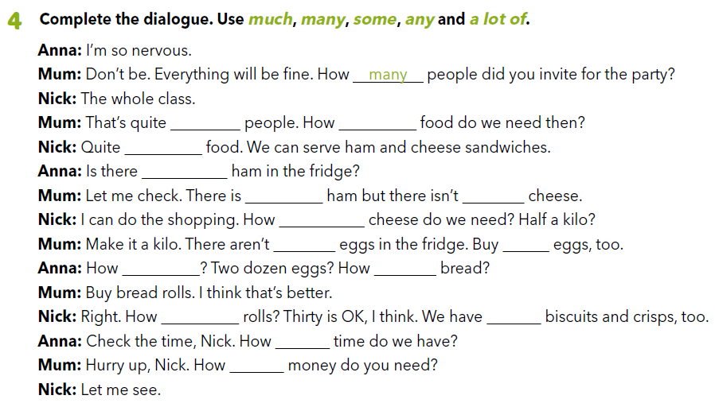
a lot of
much
a lot of
any
some
any
much
any
some
many
much
many
some
much
much

Slide 12
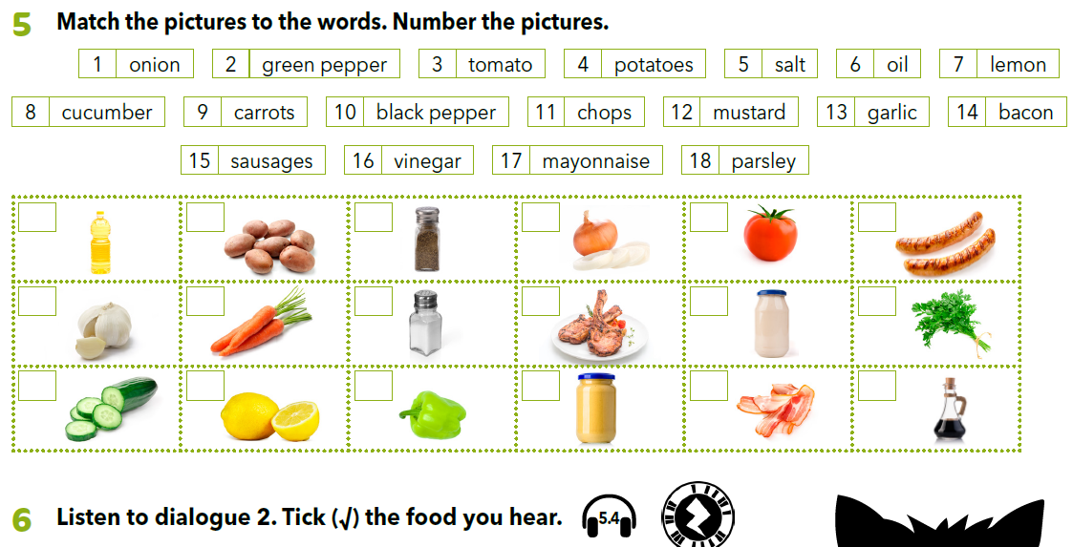

https://www.e-sfera.hr/dodatni-digitalni-sadrzaji/60588585-6c92-45eb-9214-dc9545e4a383/assets/audio/26__unit_05_lesson_3_-_a_visit_to_the_country_-_part_3.mp3

Slide 13

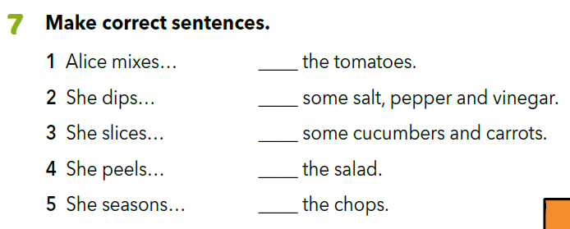
3
1
4
5
2
What is for dinner?
Who is helping with the barbecue?
What does grandpa usually use for the dip?
What does Alice have to pick in the garden?
What does she do with the tomatoes?
What does she do with the cucumbers?

Slide 14
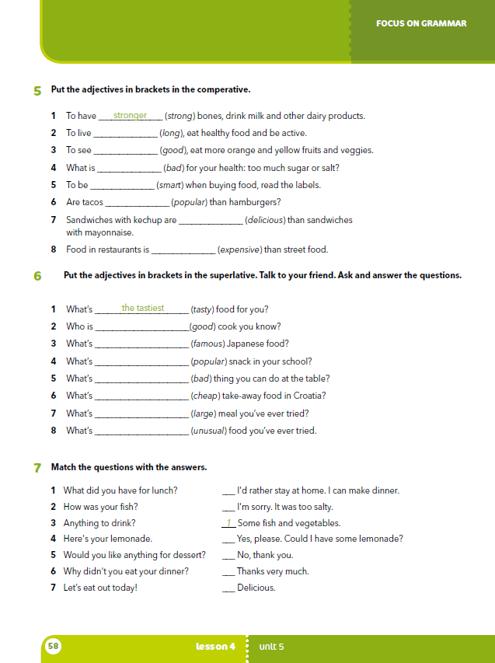
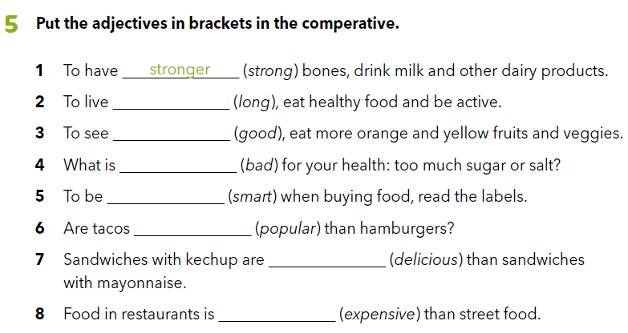
Workbook, p. 58
longer
better
worse
smarter
more popular
more delicious
more expensive

Slide 15

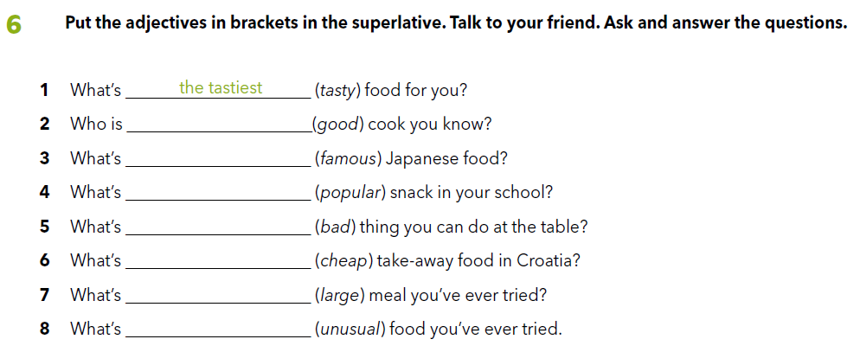
the best
the most famous
the most popular
the worst
the cheapest
the largest
the most unusual

Slide 16
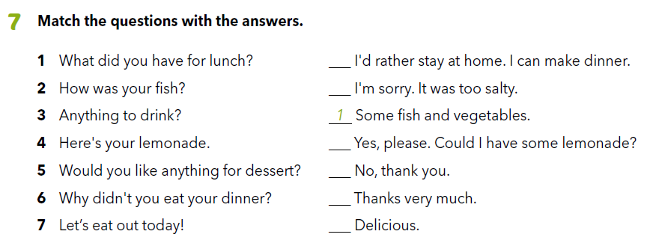
7
6
3
5
4
2

